Slide 1
Duplicate Data
Examples
If we were to use only student’ names as our way to identify students – that may not work, especially in China because a school may have more than one Jie Liu, a very common first name (Jie) and very common last name (Liu).
Normalization wants to deal with duplicate data

Slide 2
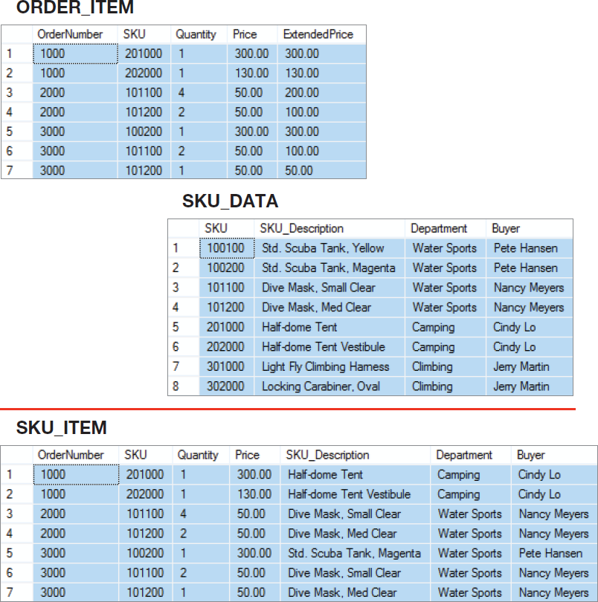
How Many Tables?
Should we store these three tables as they are, or should we combine them into one table in our new database?
Notes:
You can design the new database to store this data as two separate tables, or you can join the tables together and design the database with just one table.
Each alternative has advantages and disadvantages. When you make the decision to use one design, you obtain certain advantages at the expense of certain costs.
The purpose of this chapter is to help you understand those advantages and costs.

Slide 3
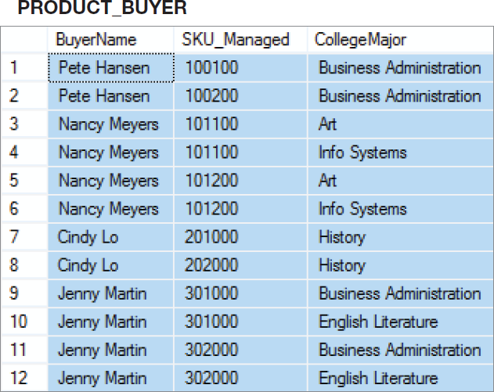
A Very Strange Table!
Major?
To understand why this is a very strange table, consider how you would add the fact that Nancy Meyers is now managing SKU 101300!
Notes:
To understand why this is an odd table, suppose that Nancy Meyers is assigned a new SKU, say 101300. What addition should we make to this table?
Clearly, we need to add a row for the new SKU, but if we add just one row, say the row ('Nancy Meyers', 101300, 'Art'), it will appear that she manages product 101300 as an Art major, but not as an Info Systems major.
To avoid such an illogical state, we need to add two rows:
('Nancy Meyers', 101300, 'Art') and ('Nancy Meyers', 101300, 'Info Systems').
Now, that is strange!

Slide 4
But First—
We need to understand:
The relational model
Relational model terminology

Slide 5
The Relational Model
Introduced in a paper published in 1970.
Created by E.F. Codd
He was an IBM engineer
The model used mathematics known as “relational algebra”
Now the standard model for commercial RDBMS products, the R is for relational.

Slide 6
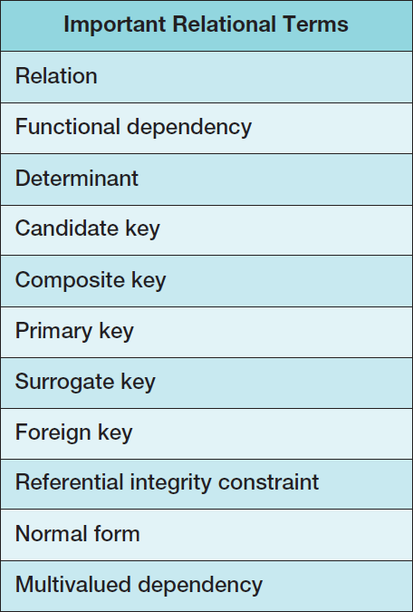
Important Relational Model Terms

Slide 7
Entity
An entity is some identifiable thing that users want to track:
Customers
Computers
Sales
Note: at WOU large trees may or may not be entity because (1) they need to be identifiable , which can be done by nailing on some ID card. But do we (WOU) want to track the trees? If yes, Tree is an entity, and can have many instances. If WOU does not want to track, then Tree is not an entity!!!

Slide 8
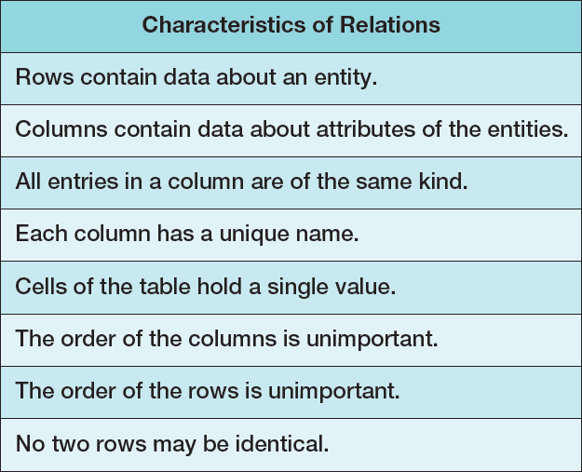
Relation
Relational DBMS products store data about entities in relations, which are a special type of table.
A relation is a two-dimensional table that has the following characteristics (this is the second time we see this list):

Slide 9
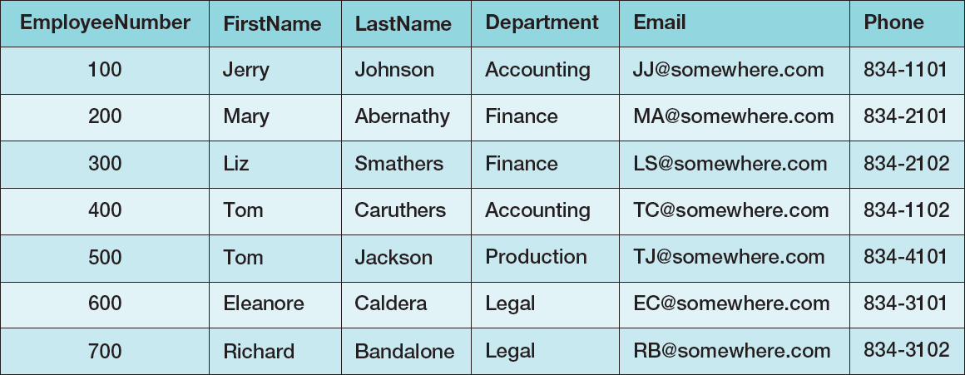
A Relation A Sample EMPLOYEE Relation
How is this different than an excel sheet?

Slide 10
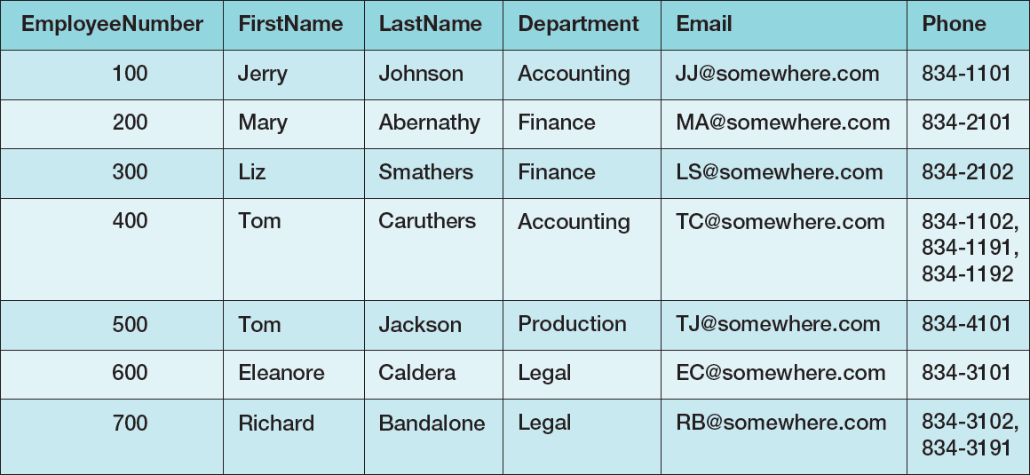
Tables That Are Not Relations: Multiple Entries per Cell
FYI: This is possible in a database

Slide 11
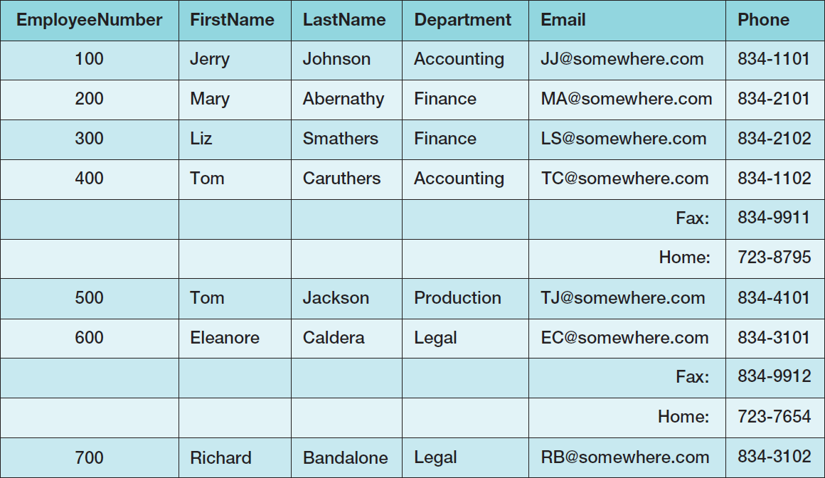
Tables That Are Not Relations: Table with Required Row Order

Slide 12
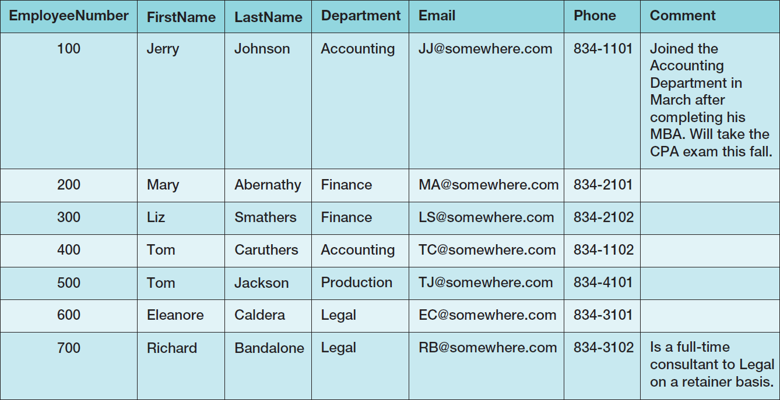
A Relation with Values of Varying Length

Slide 13
The Domain integrity Constraint
The requirement that all of the values in a column are of the same kind is know as the domain integrity constraint.
The term domain means a grouping of data that meets a specific type definition ( a math term).
FirstName could have a domain of names such as Albert, Bruce, Cathy, David, Edith, and so forth.
All values of FirstName must come from the names in that domain.
Columns in different relations may have the same name.

Slide 14
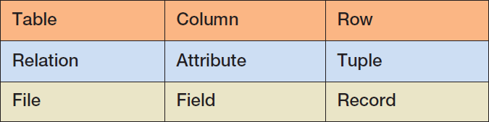
Alternative Terminology
Although not all tables are relations, the terms table and relation are normally used interchangeably in database discussions.
The following sets of terms are equivalent columns-wise:

Slide 15
To Key, or Not to Key That is the Question!
In a relation as defined by Codd:
The rows of a relation must be unique
These is no requirement for a designated primary key
The requirement for unique rows implies that a primary key can [and should – added by Jie] be designated.
In the “real world”, every relation has a primary key.
When do we designate a primary key?
We need some more information!

Slide 16
Functional Dependency
A functional dependency occurs when the value of one (set of) attribute(s) determines the value of a second (set of) attribute(s):
StudentID → StudentName
StudentID → (DormName, DormRoom, Fee)
The attribute on the left side of the functional dependency is called the determinant.
Functional dependencies may be based on equations:
ExtendedPrice = Quantity X UnitPrice
(Quantity, UnitPrice) → ExtendedPrice
Function dependencies are not equations!
The word “Determine” does not mean “making a decision,” it basic means if I look it up in the relation, it has a fixed value. In the case of
StudentID → StudentName
it basically saying that if you tell me the StudentID, there can only be one corresponding StudentName in that relation!

Slide 17
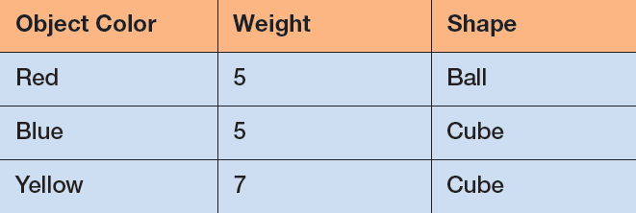
Functional Dependencies Are Not Equations
What if each color had a unique weight?
Or each color had a unique shape?
ObjectColor → Weight
ObjectColor → Shape
ObjectColor → (Weight, Shape)
Notes:
Perhaps the easiest way to understand functional dependencies is:
If I tell you one specific fact, can you respond with a unique
associated fact?
Using the table above, if I tell you that that the ObjectColor is Red, can you uniquely tell me the associated Shape?
Yes, you can and it is Ball. Therefore, ObjectColor deter- mines Shape, and a functional dependency exists with ObjectColor as the determinant.
Now, if I tell you that that the Shape is Cube, can you uniquely tell me the associated ObjectColor?
No, you cannot because it could be either Blue or Yellow. Therefore, Shape does not determine ObjectColor, and ObjectColor is not functionally dependent on Shape.

Slide 18
Composite Determinants
Composite determinant = a determinant of a functional dependency that consists of more than one attribute
(StudentNumber, ClassName) → (Grade)

Slide 19
Functional Dependency Rules
If A → (B, C), then A → B and A→ C.
This is the decomposition rule.
If A → B and A→ C, then A → (B, C).
This is the union rule.
However, if (A,B) → C, then neither A nor B MAY determine C by itself.

Slide 20
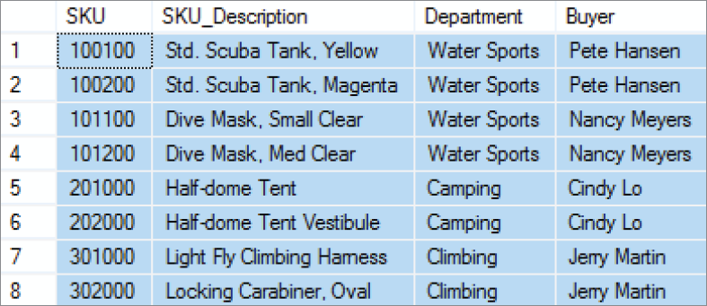
Functional Dependencies in the SKU_DATA Table
What are the functional dependencies here?

Slide 21
Functional Dependencies in the SKU_DATA Table
SKU → (SKU_Description, Department, Buyer)
SKU_Description → (SKU, Department, Buyer)
Buyer → Department
Notes:
As stated, for the Buyer determines Department functional dependency, a Buyer is paired with one and only one value of Department.
Notice that a buyer can appear more than once in the table, but, if so, that buyer is always paired with the same department.
This is true for all functional dependencies. If A determines B, then each value of A will be paired with one and only one value of B. A particular value of A may appear more than once in the relation, but, if so, it is always paired with the same value of B.
Note, too, that the reverse is not necessarily true. If A determines B, then a value of B may be paired with many values of A.

Slide 22
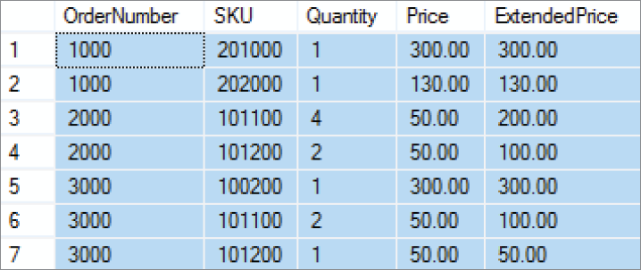
Functional Dependencies in the ORDER_ITEM Table
What are the functional dependencies?

Slide 23
Functional Dependencies in the ORDER_ITEM Table
(OrderNumber, SKU) →
(Quantity, Price, ExtendedPrice)
(Quantity, Price) → (ExtendedPrice)
Notes:
You cannot always determine functional dependencies from sample data.
You may not have any sample data, or you may have just a few rows that are not representative of all of the data conditions. In such cases, you must ask the users who are experts in the application that creates the data.
For the SKU_DATA table, you would ask questions such as, “Is a Buyer always associated with the same Department?” and “Can a Department have more than one Buyer?”
In most cases, answers to such questions are more reliable than sample data. When in doubt, trust the users.

Slide 24
What Makes Determinant Values Unique?
A determinant is unique in a relation if and only if, it determines every other column in the relation.
You cannot find the determinants of all functional dependencies simply by looking for unique values in one column:
Data set limitations (more data will come)
Must be logically a determinant (such as SSN determines Last Name, DOB, etc)

Slide 25
Keys
A key is one or more columns that is used to identify rows in a relation.
A composite key is a key that consists of two or more columns.
In the STUDENT table, SID is a key
In the ENROLLMENT table, SID + ClassName forms the key.

Slide 26
Candidate and Primary Keys
A candidate key is a key that determines all of the other columns in a relation.
A relation may have several candidate keys
A primary key is a candidate key selected as the primary means of identifying rows in a relation.
There is only one primary key per relation.
The primary key may be a composite key.
The ideal primary key is short, numeric, and never changes.
A primary key is always a candidate key, a candidate key may or may not be a primary key.
This is similar to presidential elections. We may have several candidate, only one of them is be selected as the president.
Notes:
What do you do if a table has no candidate keys?
In that case, define the primary key as the collection of all of the columns in the table.
Because there are no duplicate rows in a stored relation, the combination of all of the columns of the table will always be unique.
Again, although tables generated by SQL manipulation may have duplicate rows, the tables that you design to be stored should never be constructed to have data duplication.
Thus, the combination of all columns is always a candidate key.

Slide 27
The Entity integrity Constraint
The requirement that, in order to function properly, the primary key must have unique data values for every row in the table is know as the entity integrity constraint.
The phrase unique data values implies that this column is NOT NULL, and does not allow a NULL value in any row.

Slide 28
Surrogate Keys
A surrogate key is an artificial column added to a relation to serve as a primary key.
DBMS supplied
Short, numeric, and never changes—an ideal primary key
Has artificial values that are meaningless to users
Normally hidden in forms and reports
WOU’s student V-numbers are an excellent example of surrogate keys

Slide 29
Foreign Keys
A foreign key is the primary key of one relation that is placed in another relation to form a link between the relations.
A foreign key can be a single column or a composite key.
The term refers to the fact that key values are foreign to the relation in which they appear as foreign key values.
SNO and PNO in SP table of lab2 are foreign keys
In our database definition, one of the important characteristics is the “integrated” concept, foreign keys achieve/implement that “integrated” concept

Slide 30
Foreign Keys
NOTE: The primary keys of the relations are underlined and any foreign keys are in italics in the relations below:
DEPARTMENT (DepartmentName, BudgetCode, ManagerName)
EMPLOYEE (EmployeeNumber, EmployeeLastName,
EmployeeFirstName, DepartmentName)

Slide 31
The Referential Integrity Constraint
A referential integrity constraint is a statement that limits the values of the foreign key to those already existing as primary key values in the corresponding relation:
SKU in ORDER_ITEM must exist in SKU in SKU_DATA

Slide 32
Foreign Key with a Referential Integrity Constraint
NOTE: The primary key of the relation is underlined and any foreign keys are in italics in the relations below:
SKU_DATA (SKU, SKU_Description, Department, Buyer)
ORDER_ITEM (OrderNumber, SKU, Quantity, Price, ExtendedPrice)
Where ORDER_ITEM.SKU must exist in SKU_DATA.SKU
Notes:
While we have defined a referential integrity constraint to require a corresponding primary key value in the linked table, the technical definition of the referential integrity constraint allows for one other option—that the foreign key cell in the table is empty and does not have a value.
If a cell in a table does not have a value, it is said to have a null value (we will discuss null values in Chapter 4).
It is difficult to imagine a foreign key having null values in a real database when the referential integrity constraint is actually in use, and we will stick with our basic definition of the referential integrity constraint in this book. At the same time, be aware that the complete, formal definition of the referential integrity constraint does allow for null values in foreign key columns.

Slide 33
Database Integrity
We have defined three constraints so far in our discussion:
The domain integrity constraint (column is unique)
The entity integrity constraint (row is unique)
The referential integrity constraint
The purpose of these three constraints, taken as a whole, is to create database integrity, which means that the data in our database will be useful, meaningful data, and referable.

Slide 34
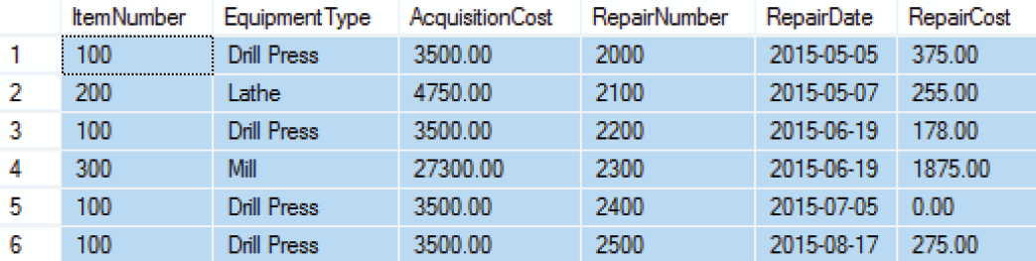
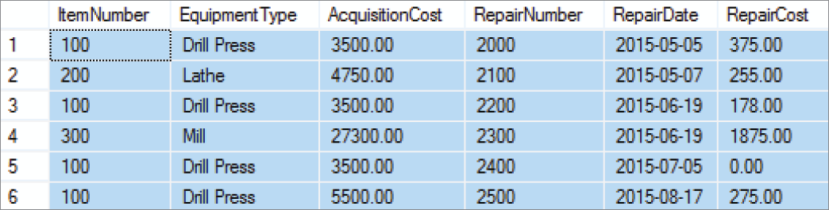
Modification Anomalies
The EQUIPMENT_REPAIR table before and after an incorrect update operation on AcquisitionCost for EquipmentType = Drill Press:
What if we deleted
Row 2?
What if we wanted to add a row?
What happens now?

Slide 35
Types of Modification Anomalies
Deletion anomaly
Insertion anomaly
Update anomaly
Notice that the EQUIPMENT_REPAIR table duplicates data. For example, the AcquisitionCost of the same item of equipment appears several times. Any table that duplicates data is susceptible to update anomalies. A table that has such inconsistencies is said to have data integrity problems.
If you are not clear about the anomalies, please read the book and google the internet

Slide 36
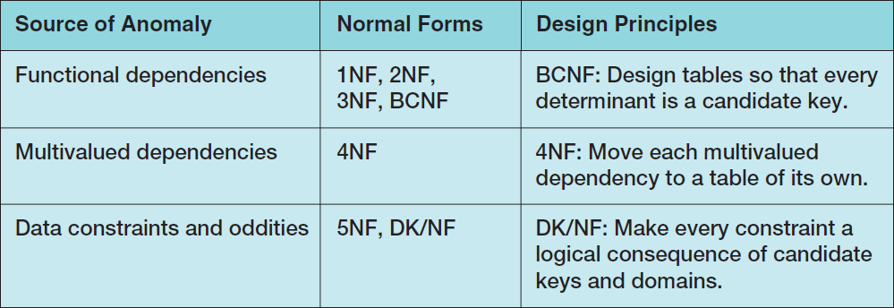
Normal Forms
Relations are categorized as a normal form based on which modification anomalies or other problems they are subject to:

Slide 37
To Key, or Not to Key Here is the Answer!
There are various opinions about whether or not a relation has to have a designated primary key to be in 1NF.
In this book, we will define 1NF as a table that:
Meet the set of conditions for a relation, and
Has a defined primary key

Slide 38
Normal Forms
Determinant
“what do I need to know to find your name?”
“….age”
“….qpa”
The answer is V-number because that is the DETERMINANT!
Functional Dependency
X → Y if I know X I can find out Y

Slide 39
Normal Forms
1NF—a table that qualifies as a relation is in 1NF.
2NF—a relation is in 2NF if all of its nonkey attributes are dependent on all of the primary keys.
3NF—a relation is in 3NF if it is in 2NF and has no other determinants except the primary key.
Boyce-Codd Normal Form (BCNF)—a relation is in BCNF if every determinant is a candidate key.
“I swear to construct my tables so that all nonkey columns are dependent on the key, the whole key and nothing but the key, so help me Codd.”

Slide 40
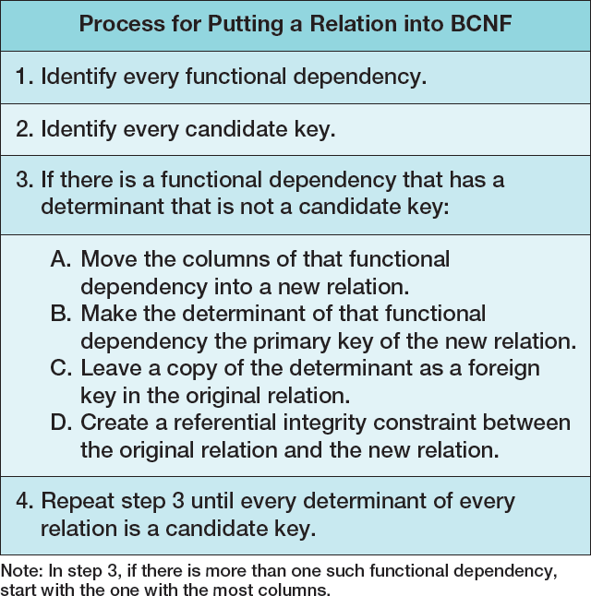
Eliminating Modification Anomalies from Functional Dependencies in Relations: Put All Relations into BCNF
Notes:
There is another, more intuitive way to think about normalization. Do you remember your eighth-grade English teacher? She said that every paragraph should have a single theme. If you write a paragraph that has two themes, you should break it up into two paragraphs, each with a single theme.
The problem with the EQUIPMENT_REPAIR relation is that it has two themes: one about repairs and a second about items. We eliminated modification anomalies by breaking that single table with two themes into two tables, each with a single theme.
Sometimes, it is helpful to look at a table and ask, “How many themes does it have?”
If it has more than one, then redefine the table so that it has a single theme.

Slide 41
Putting a Relation into BCNF: EQUIPMENT_REPAIR

Slide 42
Putting a Relation into BCNF: EQUIPMENT_REPAIR
EQUIPMENT_REPAIR (ItemNumber, Type, AcquisitionCost, RepairNumber, RepairDate, RepairAmount)
ItemNumber → (Type, AcquisitionCost)
RepairNumber → (ItemNumber, Type, AcquisitionCost, RepairDate, RepairAmount)
ITEM (ItemNumber, Type, AcquisitionCost)
REPAIR (RepairNumber, ItemNumber, RepairDate, RepairAmount)
Where REPAIR.ItemNumber must exist in ITEM.ItemNumber

Slide 43
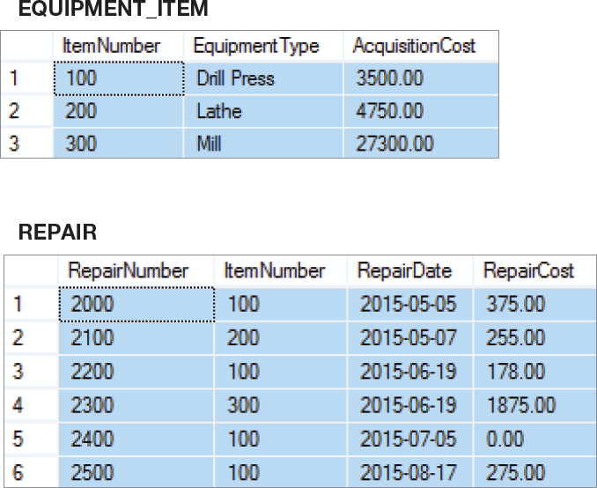
Putting a Relation into BCNF: New Relations

Slide 44
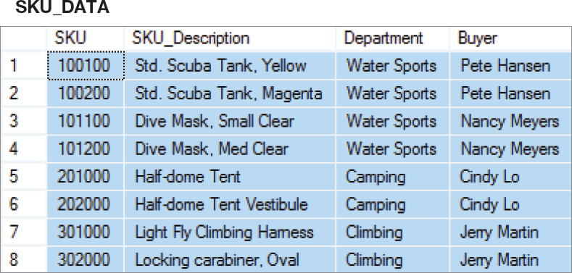
Putting a Relation into BCNF: SKU_DATA Step-by-Step – 1NF
SKU_DATA (SKU, SKU_Description, Department, Buyer)
1NF - Checking against the definition of 1NF, this relation is in 1NF.

Slide 45
Putting a Relation into BCNF: SKU_DATA Step-by-Step – 2NF
SKU_DATA (SKU, SKU_Description, Department, Buyer)
SKU → (SKU_Description, Department, Buyer)
SKU_Description → (SKU, Department, Buyer)
Buyer → Department
— SKU and SKU_Description are candidate keys.
— A relation is in 2NF if and only if it is in 1NF and all non-key attributes are determined by the primary key.
— Since SKU is a single column primary key, all non-key attributes are determined by SKU, and the relation is in 2NF.

Slide 46
Putting a Relation into BCNF: SKU_DATA Step-by-Step – 3NF
SKU_DATA (SKU, SKU_Description, Department, Buyer)
SKU → (SKU_Description, Department, Buyer)
SKU_Description → (SKU, Department, Buyer)
Buyer → Department
— SKU and SKU_Description are candidate keys.
— A relation is in 3NF if and only if it is in 2NF and there are no non-key attributes determined by another non-key attribute.
— However, the term non-key attribute means an attribute that is neither (1) a candidate key itself, nor (2) part of a composite candidate key.
— Therefore, the only non key attribute is Buyer, and it is a determinant. — Therefore, not in 3NF.

Slide 47
Putting a Relation into BCNF: SKU_DATA Step-by-Step – 3NF
— Therefore, break out the Buyer → Department functional dependency.
SKU_DATA_2 (SKU, SKU_Description, Buyer)
BUYER (Buyer, Department)
Where SKU_DATA_2.Buyer must exist in BUYER.Buyer
— SKU_DATA_2 is in 3NF
— BUYER is in 3NF

Slide 48
Putting a Relation into BCNF: SKU_DATA Step-by-Step – BCNF
SKU_DATA_2 (SKU, SKU_Description, Buyer)
BUYER (Buyer, Department)
Where SKU_DATA_2.Buyer must exist in BUYER.Buyer
SKU → (SKU_Description, Department, Buyer)
SKU_Description → (SKU, Department, Buyer)
Buyer → Department
— A relation is in BCNF if and only if it is in 3NF and every determinant is a candidate-key.
— In SKU_DATA_2, both determinants are determinant keys, so SKU_DATA_2 is in BCNF.
— In BUYER, the determinant is a determinant key, so BUYER is in BCNF.

Slide 49
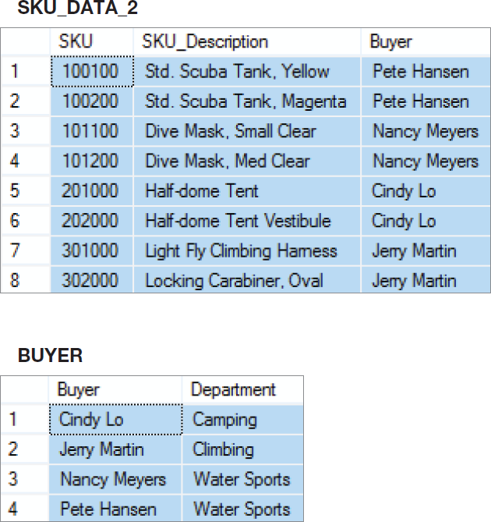
Putting a Relation into BCNF: SKU_DATA Step-by-Step – New Relations

Slide 50
Putting a Relation into BCNF: SKU_DATA Straight-to-BCNF

Slide 51
Putting a Relation into BCNF: SKU_DATA Straight-to-BCNF
SKU_DATA (SKU, SKU_Description, Department, Buyer)
SKU → (SKU_Description, Department, Buyer)
SKU_Description → (SKU, Department, Buyer)
Buyer → Department
— Therefore, break out the Buyer → Department functional dependency.
SKU_DATA (SKU, SKU_Description, Buyer)
BUYER (Buyer, Department)
Where BUYER.Buyer must exist in SKU_DATA.Buyer
Short Cut

Slide 52
Putting a Relation into BCNF: SKU_DATA Straight-to-BCNF New Relations

Slide 53
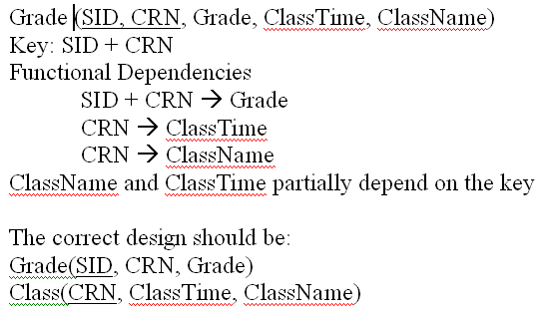
Example: Not IN 2NF

Slide 54
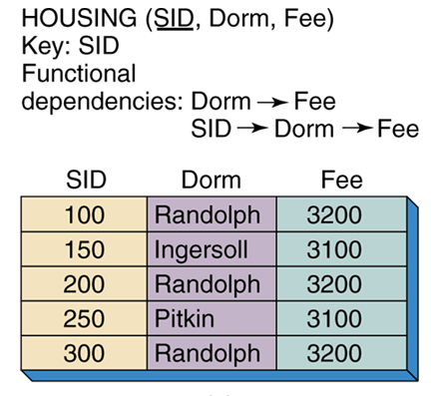
Example: NOT IN 3NF

Slide 55
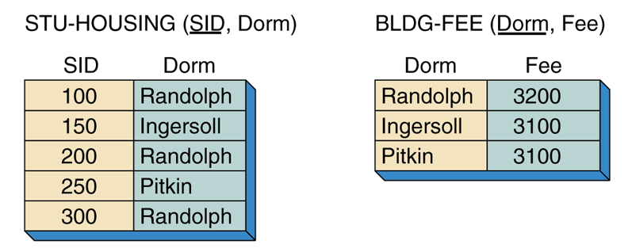
Example: 3NF

Slide 56
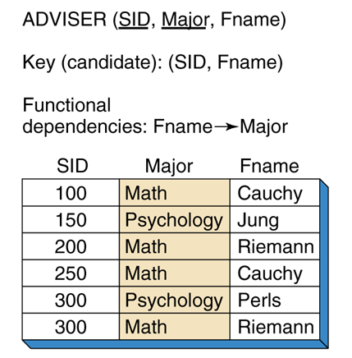
Example: NOT IN BCNF

Slide 57
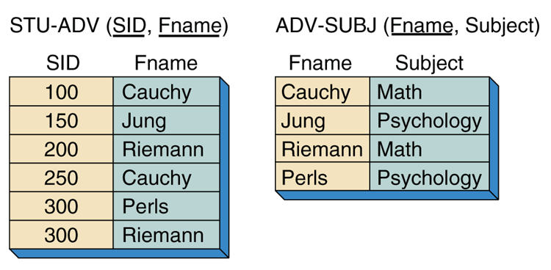
Example: BCNF

Slide 58
Multivalued Dependencies
A multivalued dependency occurs when a determinant is matched with a particular set of values:
Employee →→ Degree [Note the double arrow]
Employee →→ Sibling
PartKit →→ Part
The determinant of a multivalued dependency can never be a primary key.

Slide 59
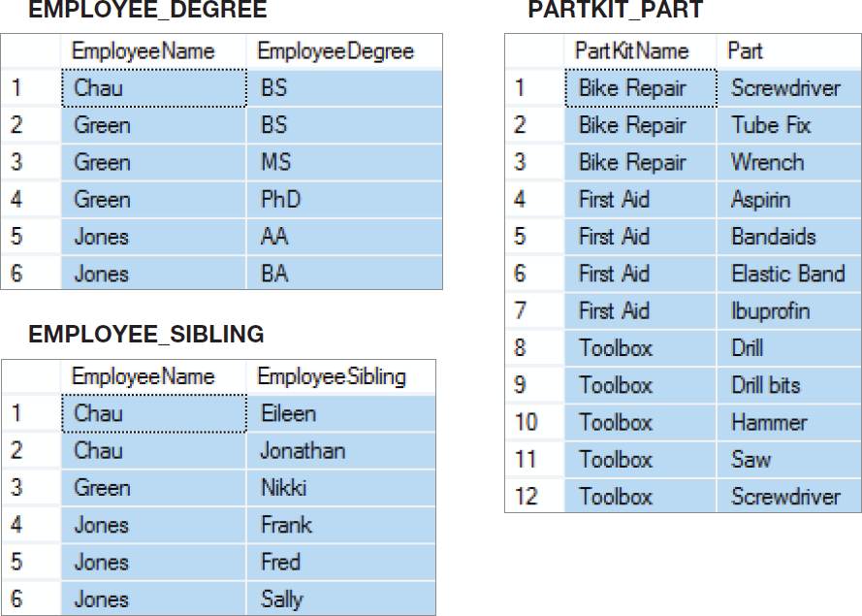
Multivalued Dependencies

Slide 60
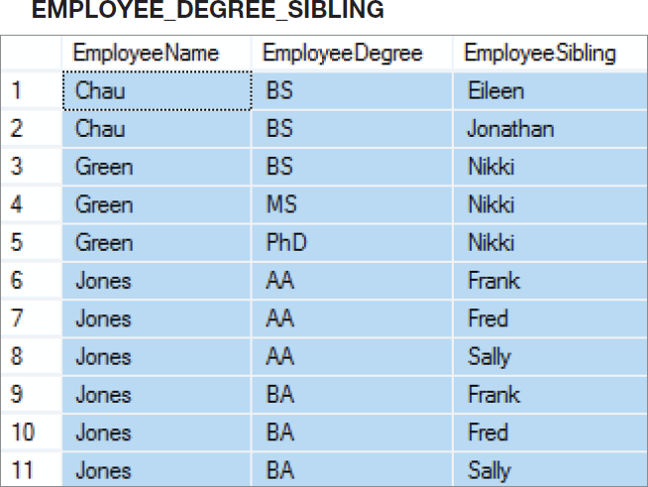
Two Multivalued Dependencies

Slide 61
Eliminating Anomalies from Multivalued Dependencies
Multivalued dependencies are not a problem if they are in a separate relation, so:
Always put multivalued dependencies into their own relation.
This is known as Fourth Normal Form (4NF).

Slide 62
That Very Strange Table Again
Now we understand why this is a very strange table.
It has multivalued dependencies!
Notes:
To understand why this is an odd table, suppose that Nancy Meyers is assigned a new SKU, say 101300. What addition should we make to this table?
Clearly, we need to add a row for the new SKU, but if we add just one row, say the row ('Nancy Meyers', 101300, 'Art'), it will appear that she manages product 101300 as an Art major, but not as an Info Systems major.
To avoid such an illogical state, we need to add two rows:
('Nancy Meyers', 101300, 'Art') and ('Nancy Meyers', 101300, 'Info Systems').
Now, that is strange!

Slide 63
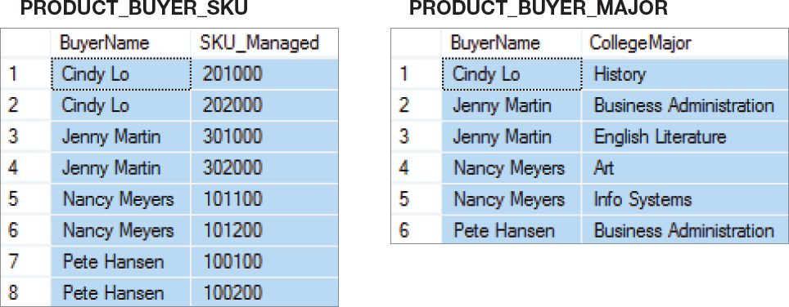
4NF
Use 4NF to resolve the multivalued dependencies!

Slide 64
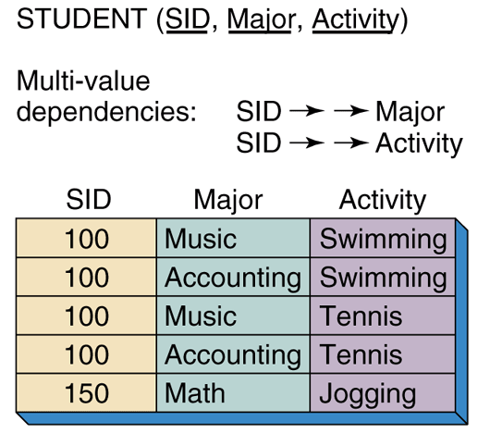
Example: NOT IN 4NF

Slide 65
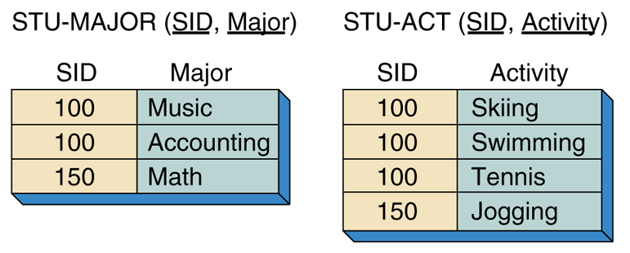
Example: 4NF

Slide 66
DK/NF
First published in 1981 by Fagin
DK/NF has no modification anomalies; so no higher normal form is needed
A relation is in DK/NF if every constraint on the relation is a logical consequence of the definition of keys and domains

Slide 67
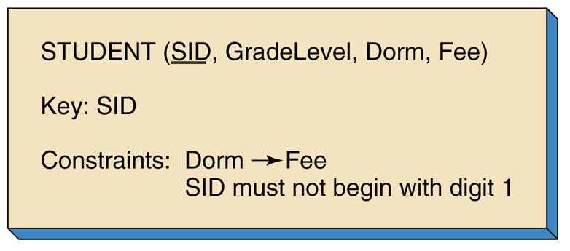
Example 1: DK/NF

Slide 68
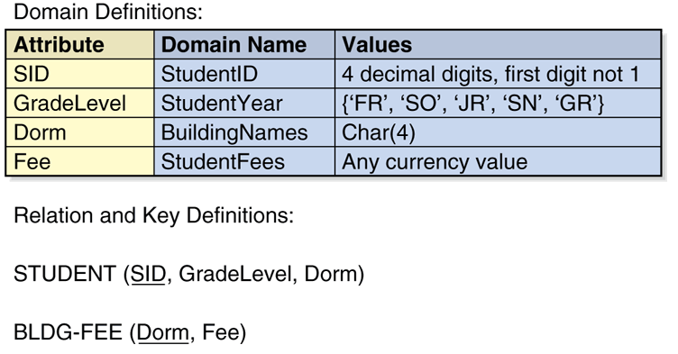
Example: DK/NF

Slide 69
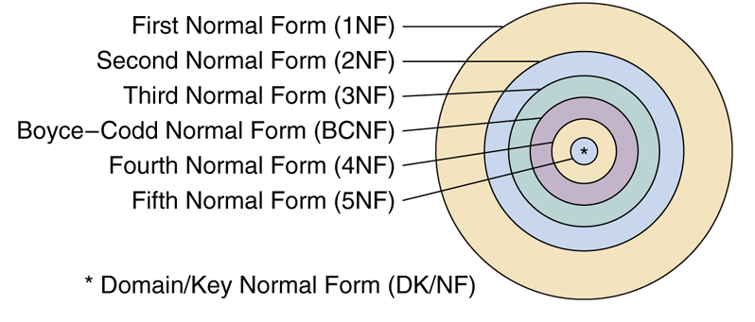
Relationship of Normal Forms
Yes, we skipped the discussion of 5 NF because it hardly every appears.

Slide 70
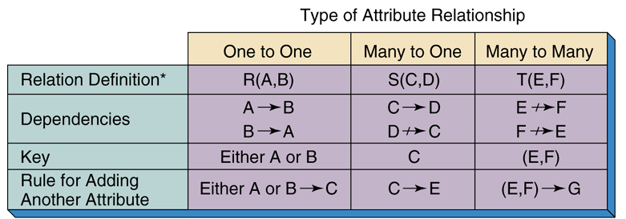
Types of Attribute Relationship

Slide 71
One-to-One Attribute Relationships
Attributes that have a one-to-one relationship must occur together in at least one relation
Call the relation R and the attributes A and B:
Either A or B must be the key of R
An attribute can be added to R if it is functionally determined by A or B
An attribute that is not functionally determined by A or B cannot be added to R
A and B must occur together in R, but should not occur together in other relations
Either A or B should be consistently used to represent the pair in relations other than R

Slide 72
Many-to-One Attribute Relationships
Attributes that have a many-to-one relationship can exist in a relation together
Assume C determines D in relation S
C must be the key of S
An attribute can be added to S if it is determined by C
An attribute that is not determined by C cannot be added to S

Slide 73
Many-to-Many Attribute Relationships
Attributes that have a many-to-many relationship can exist in a relation together
Assume attributes E and F reside together in relation T
The key of T must be (E, F)
An attribute can be added to T if it is determined by the combination (E, F)
An attribute may not be added to T if it is not determined by the combination (E, F)
If adding a new attribute, G, expands the key to (E, F, G), then the theme of the relation has been changed
Either G does not belong in T or the name of T must be changed to reflect the new theme

Slide 74
De-normalized Designs
When a normalized design is unnatural, awkward, or results in unacceptable performance, a de-normalized design is preferred
Example
Normalized relation
CUSTOMER (CustNumber, CustName, Zip)
CODES (Zip, City, State)
De-Normalized relations
CUSTOMER (CustNumber, CustName, City, State, Zip)

